Slide 1

Branching
Merging types
Lab 2
System analysis and design
Prepared by Sahar Saber & Ahmed Hatem

Slide 2
Previous Section Recap
A commit saves the state of the files at a particular point in time. Usually, we make a commit when a logical unit of work is done (ex. a new feature development is completed).
The .git directory holds an object database and metadata that makes up our repo. In fact, if we sent our .git directory to someone else that person would have our complete git project, and it's full history. They would have access to all the versions of files in any commits we made.

Slide 3
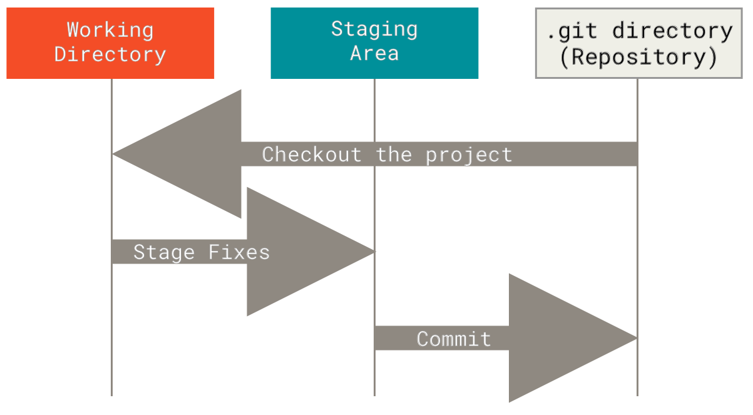
Previous Section Recap
git checkout <commitHash>
git add .
git commit -m “msg”

Slide 4
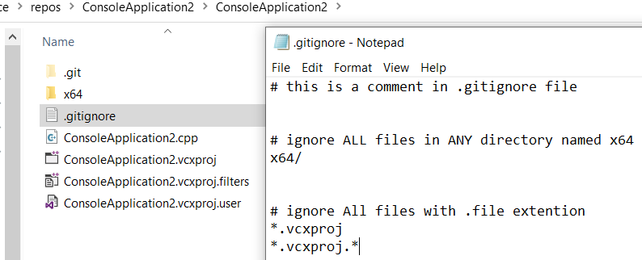
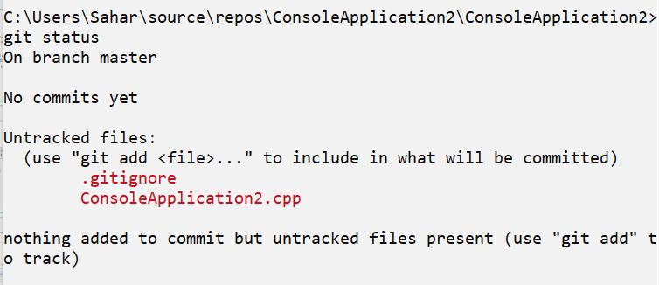
What’s the .gitignore file
It’s a plain text file used by the version control system Git to specify files and directories that should be ignored and not tracked by Git.
the .gitignore file should be committed to the repository so that all team members can benefit from the specified ignore rules.
To add .gitignore file use
Command: npm install touch-cli –g
Then command: touch .gitignore
Notes:
To add .gitignore file use npm install touch-cli –g
Then touch .gitignore

Slide 5
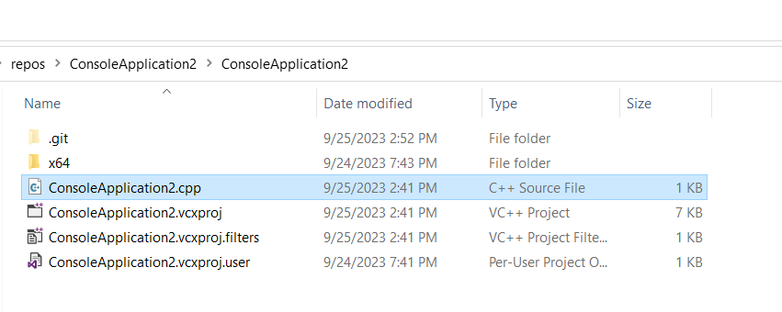
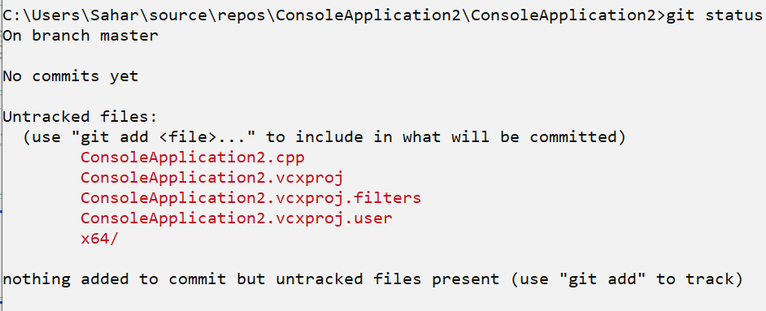
Why should we create a .ignore File
Without the .gitignore file, all the files inside the working directory are being tracked by git.
There are some files we want Git to ignore and not track in your repository (ex. Auto-generated, platform-specific, log files, temporary files, personal files, etc…)

Slide 6
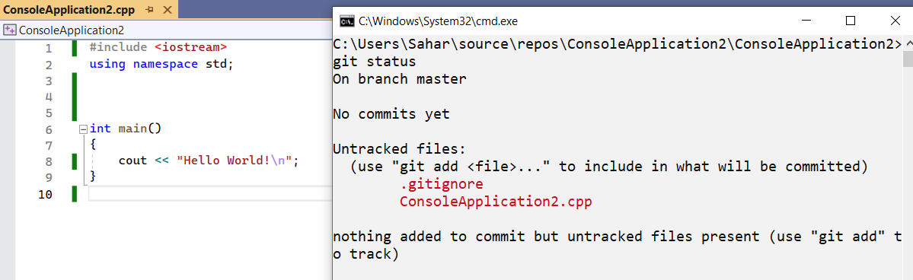
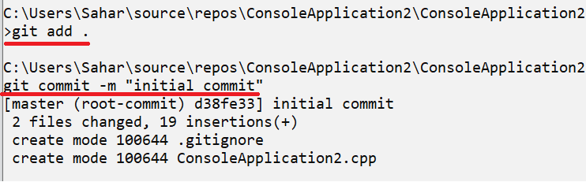
A closer look into the project files
We started with an empty c++ project, then created the first commit.

Slide 7
What is a Branch ?
Suppose you have an idea for a new feature, but you’re not sure if it’ll work out as you expect, so you do not want to risk modifying your currently working version of the code, This is where branches come in
A Git branch is a separate line of development within a Git repository, allowing you to work on specific tasks or features independently from the main codebase. It serves as an isolated workspace where you can make changes, commits, and experiments without affecting the primary project until you decide to merge those changes back
The default branch name in Git is main or master

Slide 8
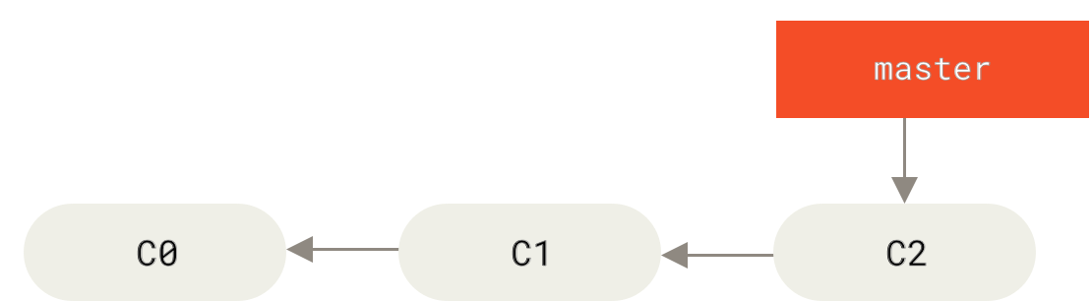
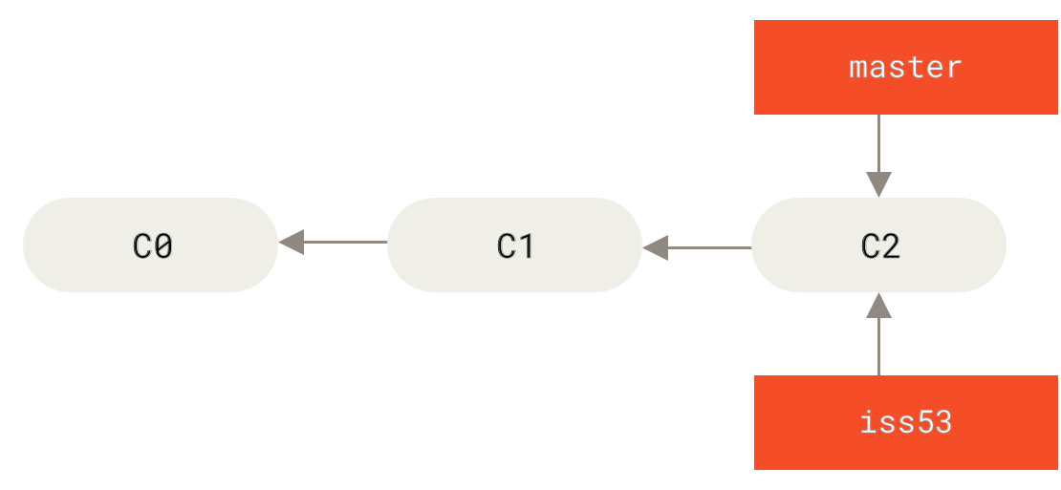
What is a Branch ?
A branch In Git is simply a lightweight movable pointer that points to a certain commit. As you start making commits, the branch pointer moves moves forward automatically to point to the last commit you made, Creating a new branch simply creates a new pointer

Slide 9
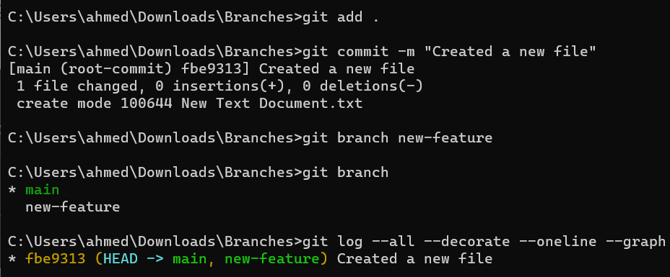
Creating a New Branch
To create a new branch, run git branch <branch-name>
To List all of the branches in your repository, run git branch
To view the git log history with more details, run git log --all --decorate --oneline --graph

Slide 10
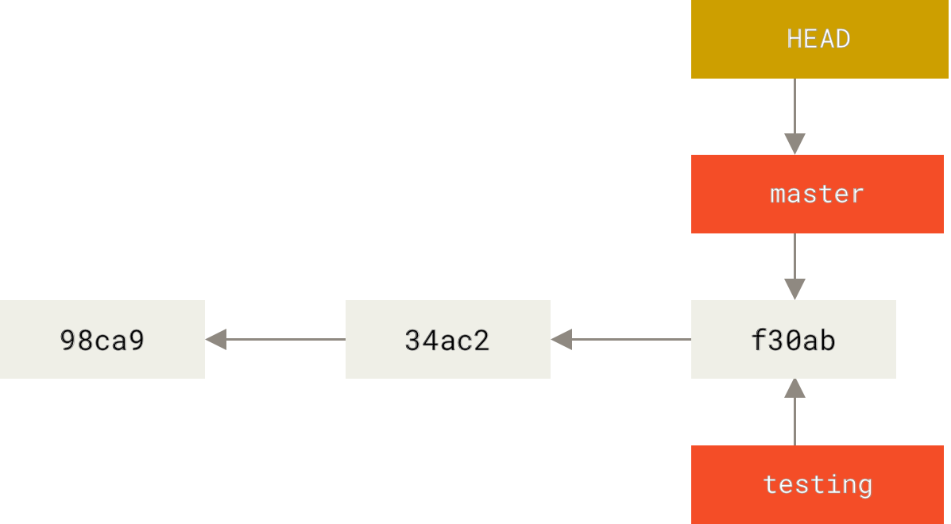
How does Git know which branch you’re on ?
Git keeps a special pointer called HEAD to track which branch you’re currently on
When we run git branch <branch-name>, a branch will be instantiated where the head pointer is, but the HEAD pointer does not move to point at the new branch

Slide 11
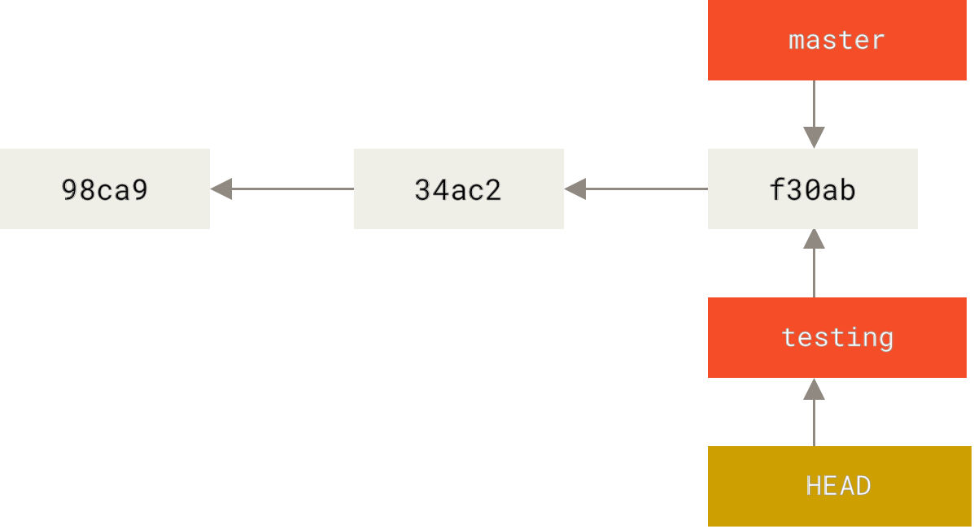
Switching to a Branch
The current branch we are on ( checked out branch ) will be marked with an asterisk (*) in the branches list shown by git branch
To move the HEAD pointer to another branch (to checkout), Run git checkout <branch-name> git checkout <commitHash> (mentioned on the previous section)
When the HEAD points to a branch, it is called a symbolic pointer. When it points to a specific commit - and not a branch- it’s called a detached HEAD.

Slide 12
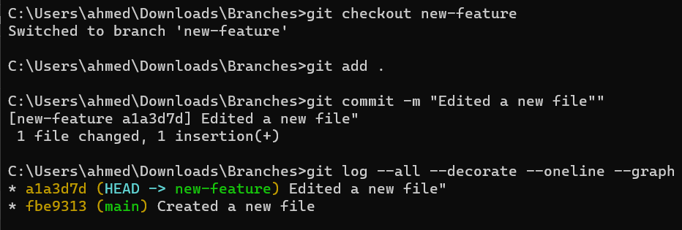
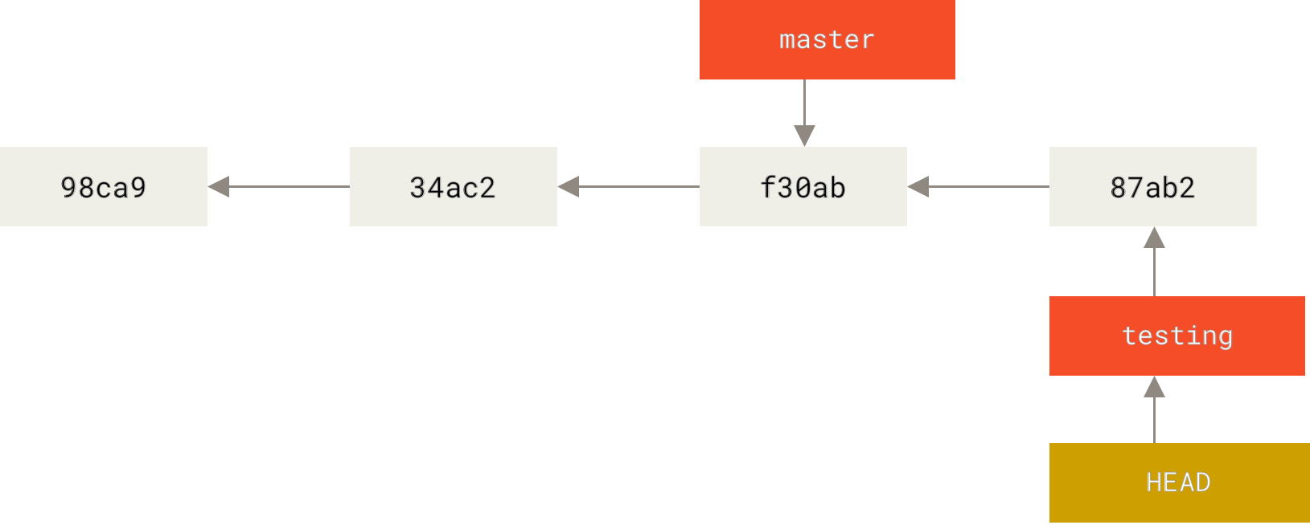
Creating New commits in a branch
When we make new commits to the current branch, both the HEAD and current branch pointers move to point at the new commit

Slide 13
Hands-on 1
Create two branches named dev, math-feature
List all the branches in the repository
Display the log history

Slide 14
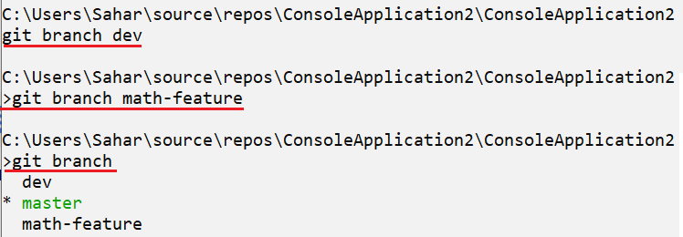

Solution
Did you notice something different??
What does the HEAD -> mean?

Slide 15
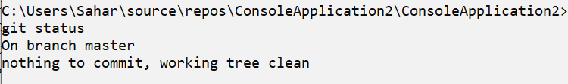
Checkout a branch
From the previous screenshot, we noticed the HEAD points to the master branch. We can make sure from that by running git status
Let’s checkout the dev branch, and make some changes to the code.

Slide 16
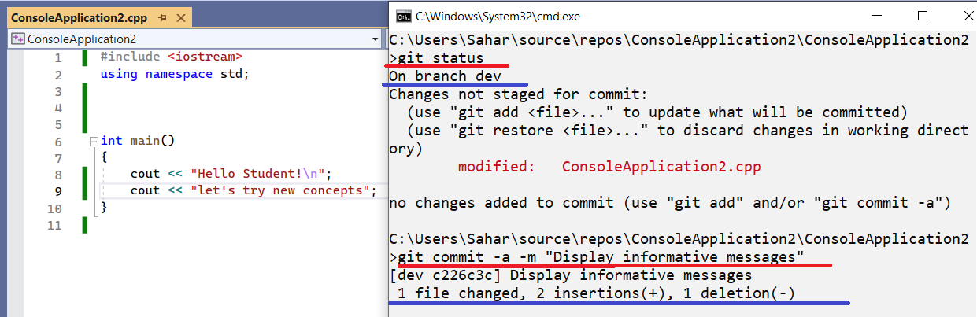

Changes on the dev branch
MCQ: The HEAD pointer points to (dev, master, math-feature)
Only the checked out branch dev will have the new commit

Slide 17
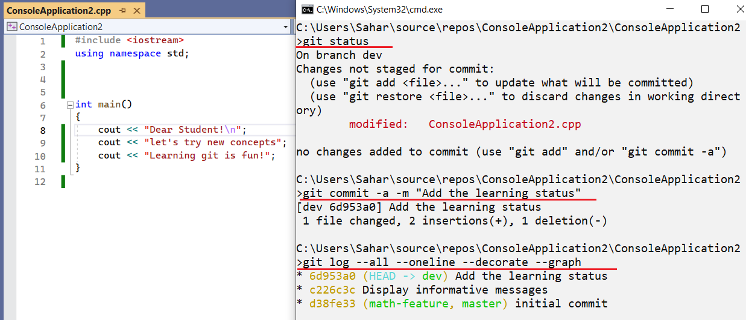
More changes in the Dev branch

Slide 18

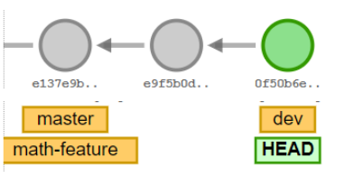
Understanding the log history

Slide 19
Fast-forward merge
We decide to include the dev changes into our master branch
First, we need to checkout the master (making the HEAD points to the master) by running git checkout master
Then type the merge command git merge dev
The checked out branch (master) will be updated to reflect the merge, but the target branch (dev) will be completely unaffected.
There are different types of merging in git, we will study them case by case starting from a fast-forward merge.
If there is a direct path from master to dev, Git will perform a fast-forward merge. It will just move the master to where dev points to.

Slide 20
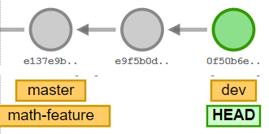
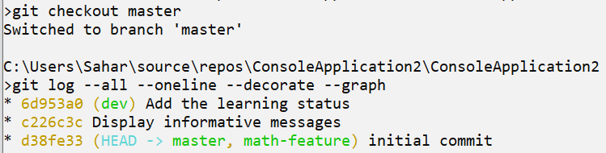
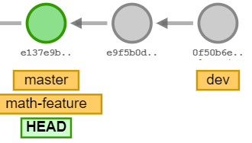
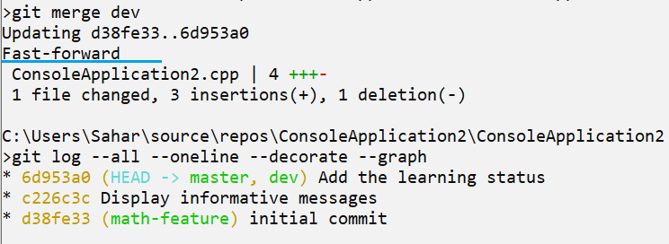
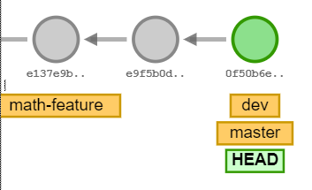
The initial log history
git checkout master
git merge dev

Slide 21
Hands-on 2
Checkout to the math-feature branch
Add a function that takes two integers and returns their sum
Display the status
Stage and commit the new changes.
Display the log history graph

Slide 22
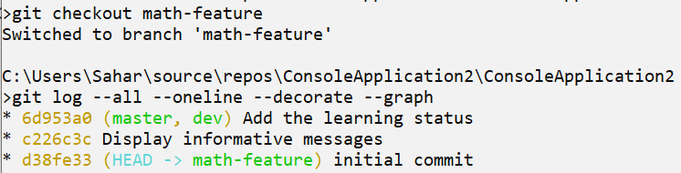
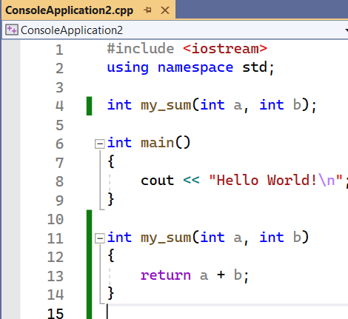
Solution
Checkout to the math-feature branch
Add a function that takes two integers and returns their sum

Slide 23
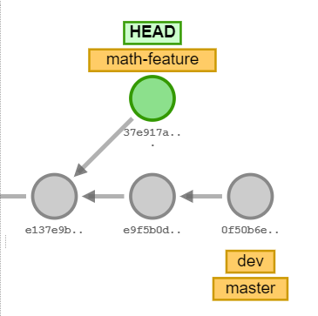
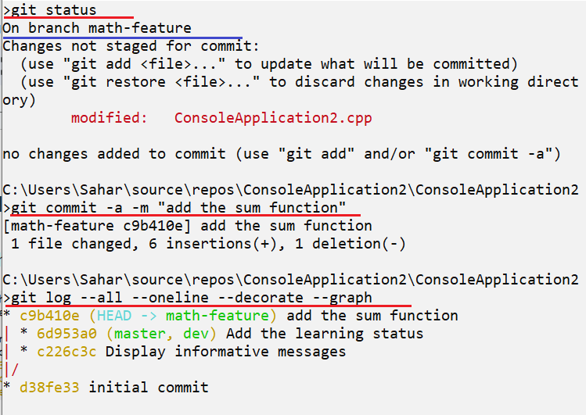
Solution
3. Display the status
4. Stage and commit the new changes.
5. Display the log history graph

Slide 24
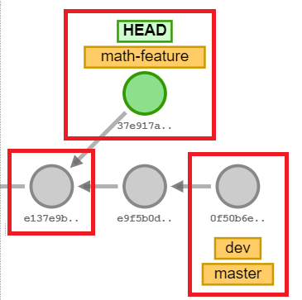
3-way merge
As there’s no direct path from the master to math-feature, merge is done recursively (3-way merge)
There will be a new commit called a merge commit. To make this merge commit, Git looks at three commits. First, the base commit the two branches started from then the last commit of each branch.
Do you think that all the 3-way merging results in conflicts?? Let’s see

Slide 25
How to merge
The merging steps are the same.
First, we need to checkout the master (making the HEAD points to the master) by running git checkout master.
Then type the merge command git merge math-feature.
The resulting output will be different based on each case.

Slide 26
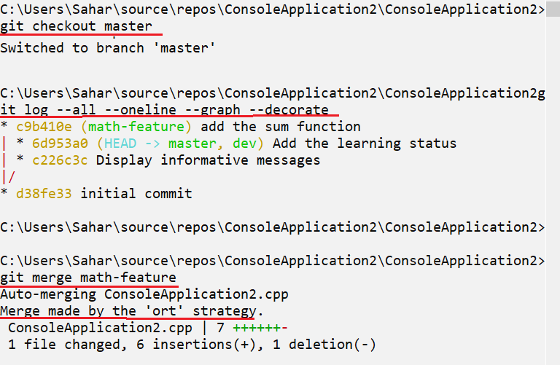
Merge steps
No conflicts happened.
Let’s debug the code!

Slide 27
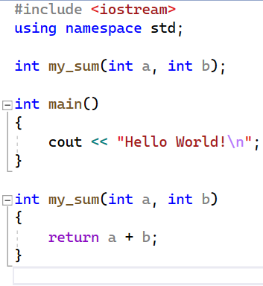
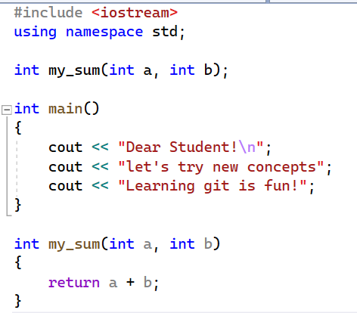
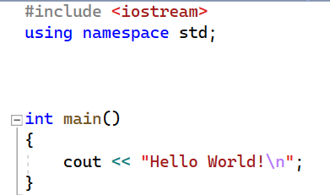
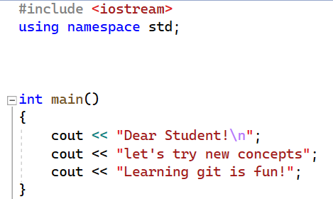
Last commit of math-feature
The merging commit
The base commit
Last commit of master

Slide 28
Last commit of math-feature
The merging commit
The base commit
A change Vs no-change, the change will win!
Last commit of master

Slide 29
Last commit of math-feature
The merging commit
The base commit
A change Vs no-change, the change will win!
<no-change>
Last commit of master

Slide 30
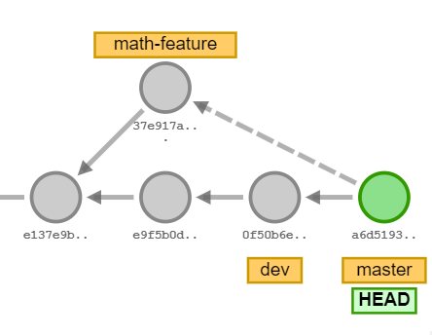
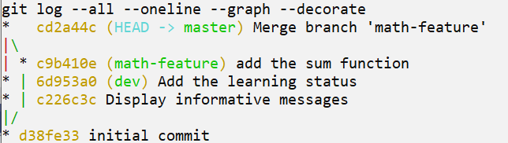
Another way of visualizing the log history graph

Slide 31
Hands-on 3
Merge the master branch into the dev branch
What’s the merge type that occurred? And why?
Merge the master into the math-feature branch.
What’s the merge type happened? And why?
Will all the branches points to the same commit?

Slide 32
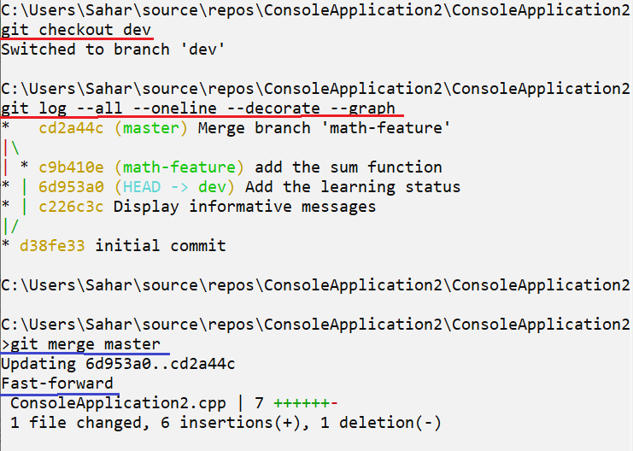
Hands-on 3 - Solution
Merge the master branch into the dev branch
What’s the merge type happened? And why?

Slide 33
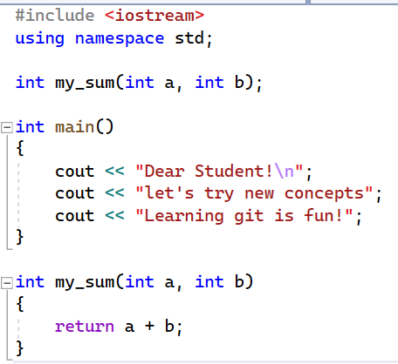
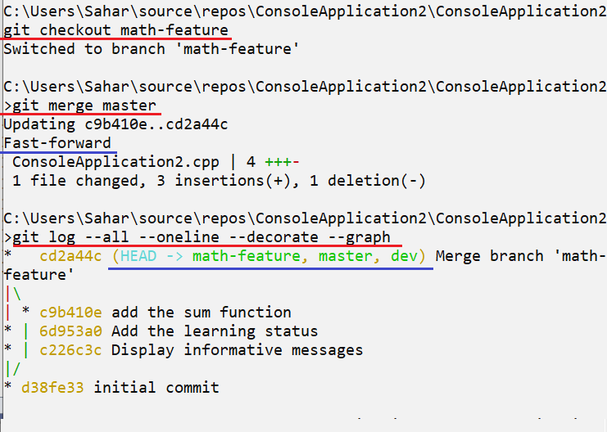
Hands-on 3 - Solution
3) Merge the master into the math-feature branch.
4) What’s the merge type happened? And why?
5) Will all the branches points to the same commit?
YES! All the branches has the following code.

Slide 34
Summary
git branch <branch-name> : A branch will be instantiated where the head pointer is.
git branch : List all the branches
git log --all --decorate --oneline --graph : Display the log history graph
git merge <feature-branch> : Merge the <feature-branch> into the checked out branch

Slide 35
References
Git documentation
Bitbucket git tutorial
Branching and merging
Rebase
If you want to go deep check: Cherry-pick

Slide 36
Thank You : )

